Slide 2
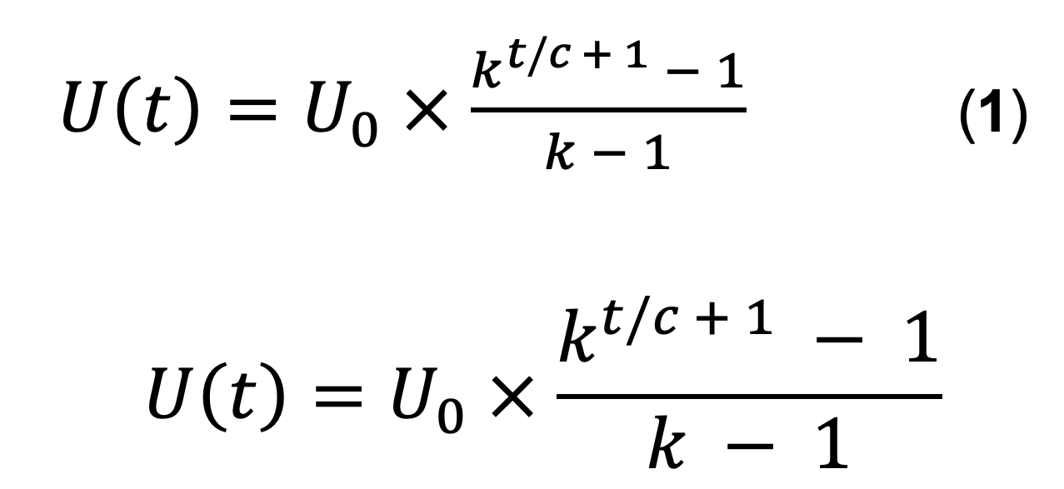

Slide 3
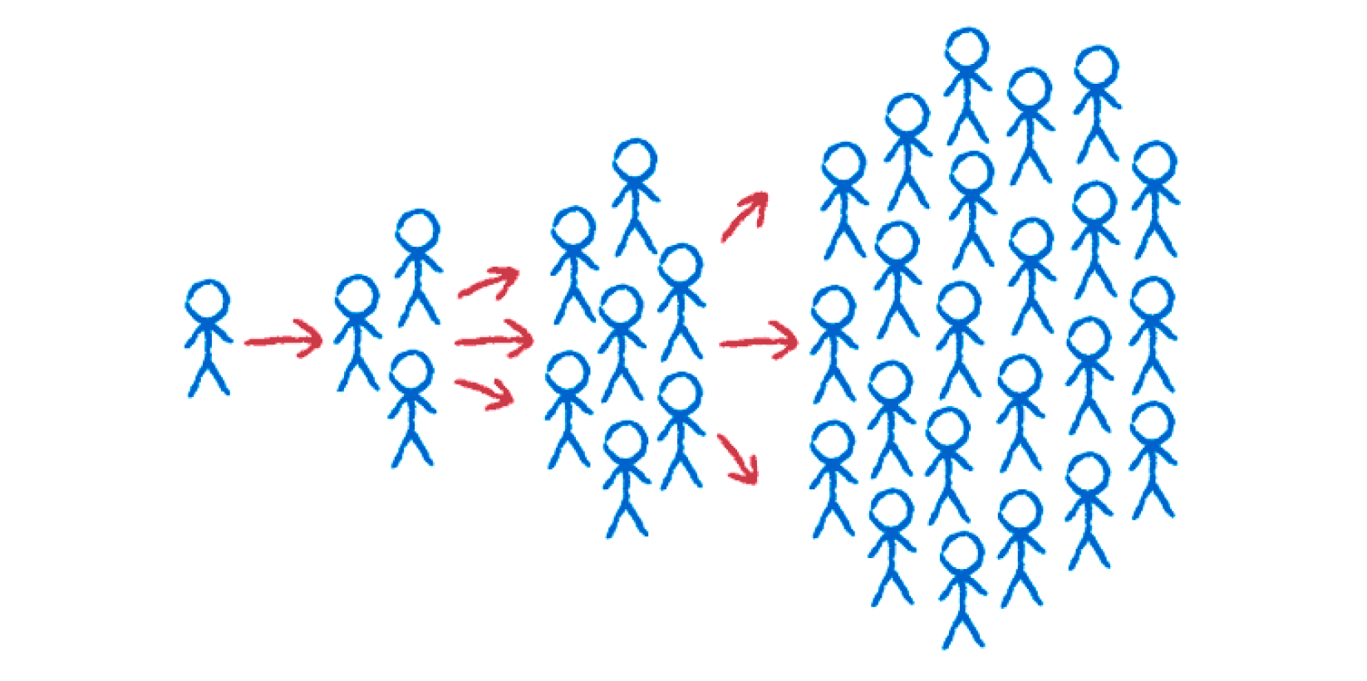

Slide 5
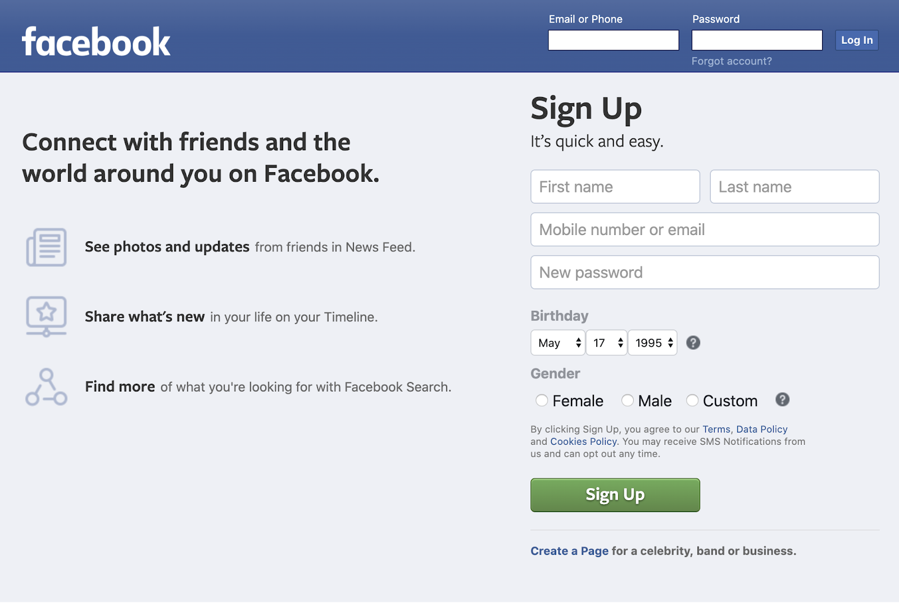
Maximize invitation rate
Current user sees
Two-way invite incentive
Pre-populated invite list
Minimal required input fields
Value proposition to new user
Invited new user sees
Maximize acceptance rate

Slide 6
Current user sees
Two-way invite incentive
Maximize invitation rate
Pre-populated invite list
Invited new user sees
Value proposition
Minimal required input fields
Maximize acceptance rate

Slide 7
Ω
Maximize invitation rate
Current user sees
Two-way invite incentive
Pre-populated invite list
Maximize acceptance rate
Invited new user sees
Value proposition
Minimal input fields

Slide 8
(Non-users)
(Non-users)
(Non-users)
conversion
Cumulative registered users
conversion
conversion
retention
retention
retention
Active users
Active users
Active users
churn (late)
resurrection
churn (late)
resurrection
churn (late)
resurrection
New users
New users
New users
Lost users
Lost users
Lost users
churn (early)
churn (early)
churn (early)
Cumulative registered users
Cumulative registered users

Slide 9
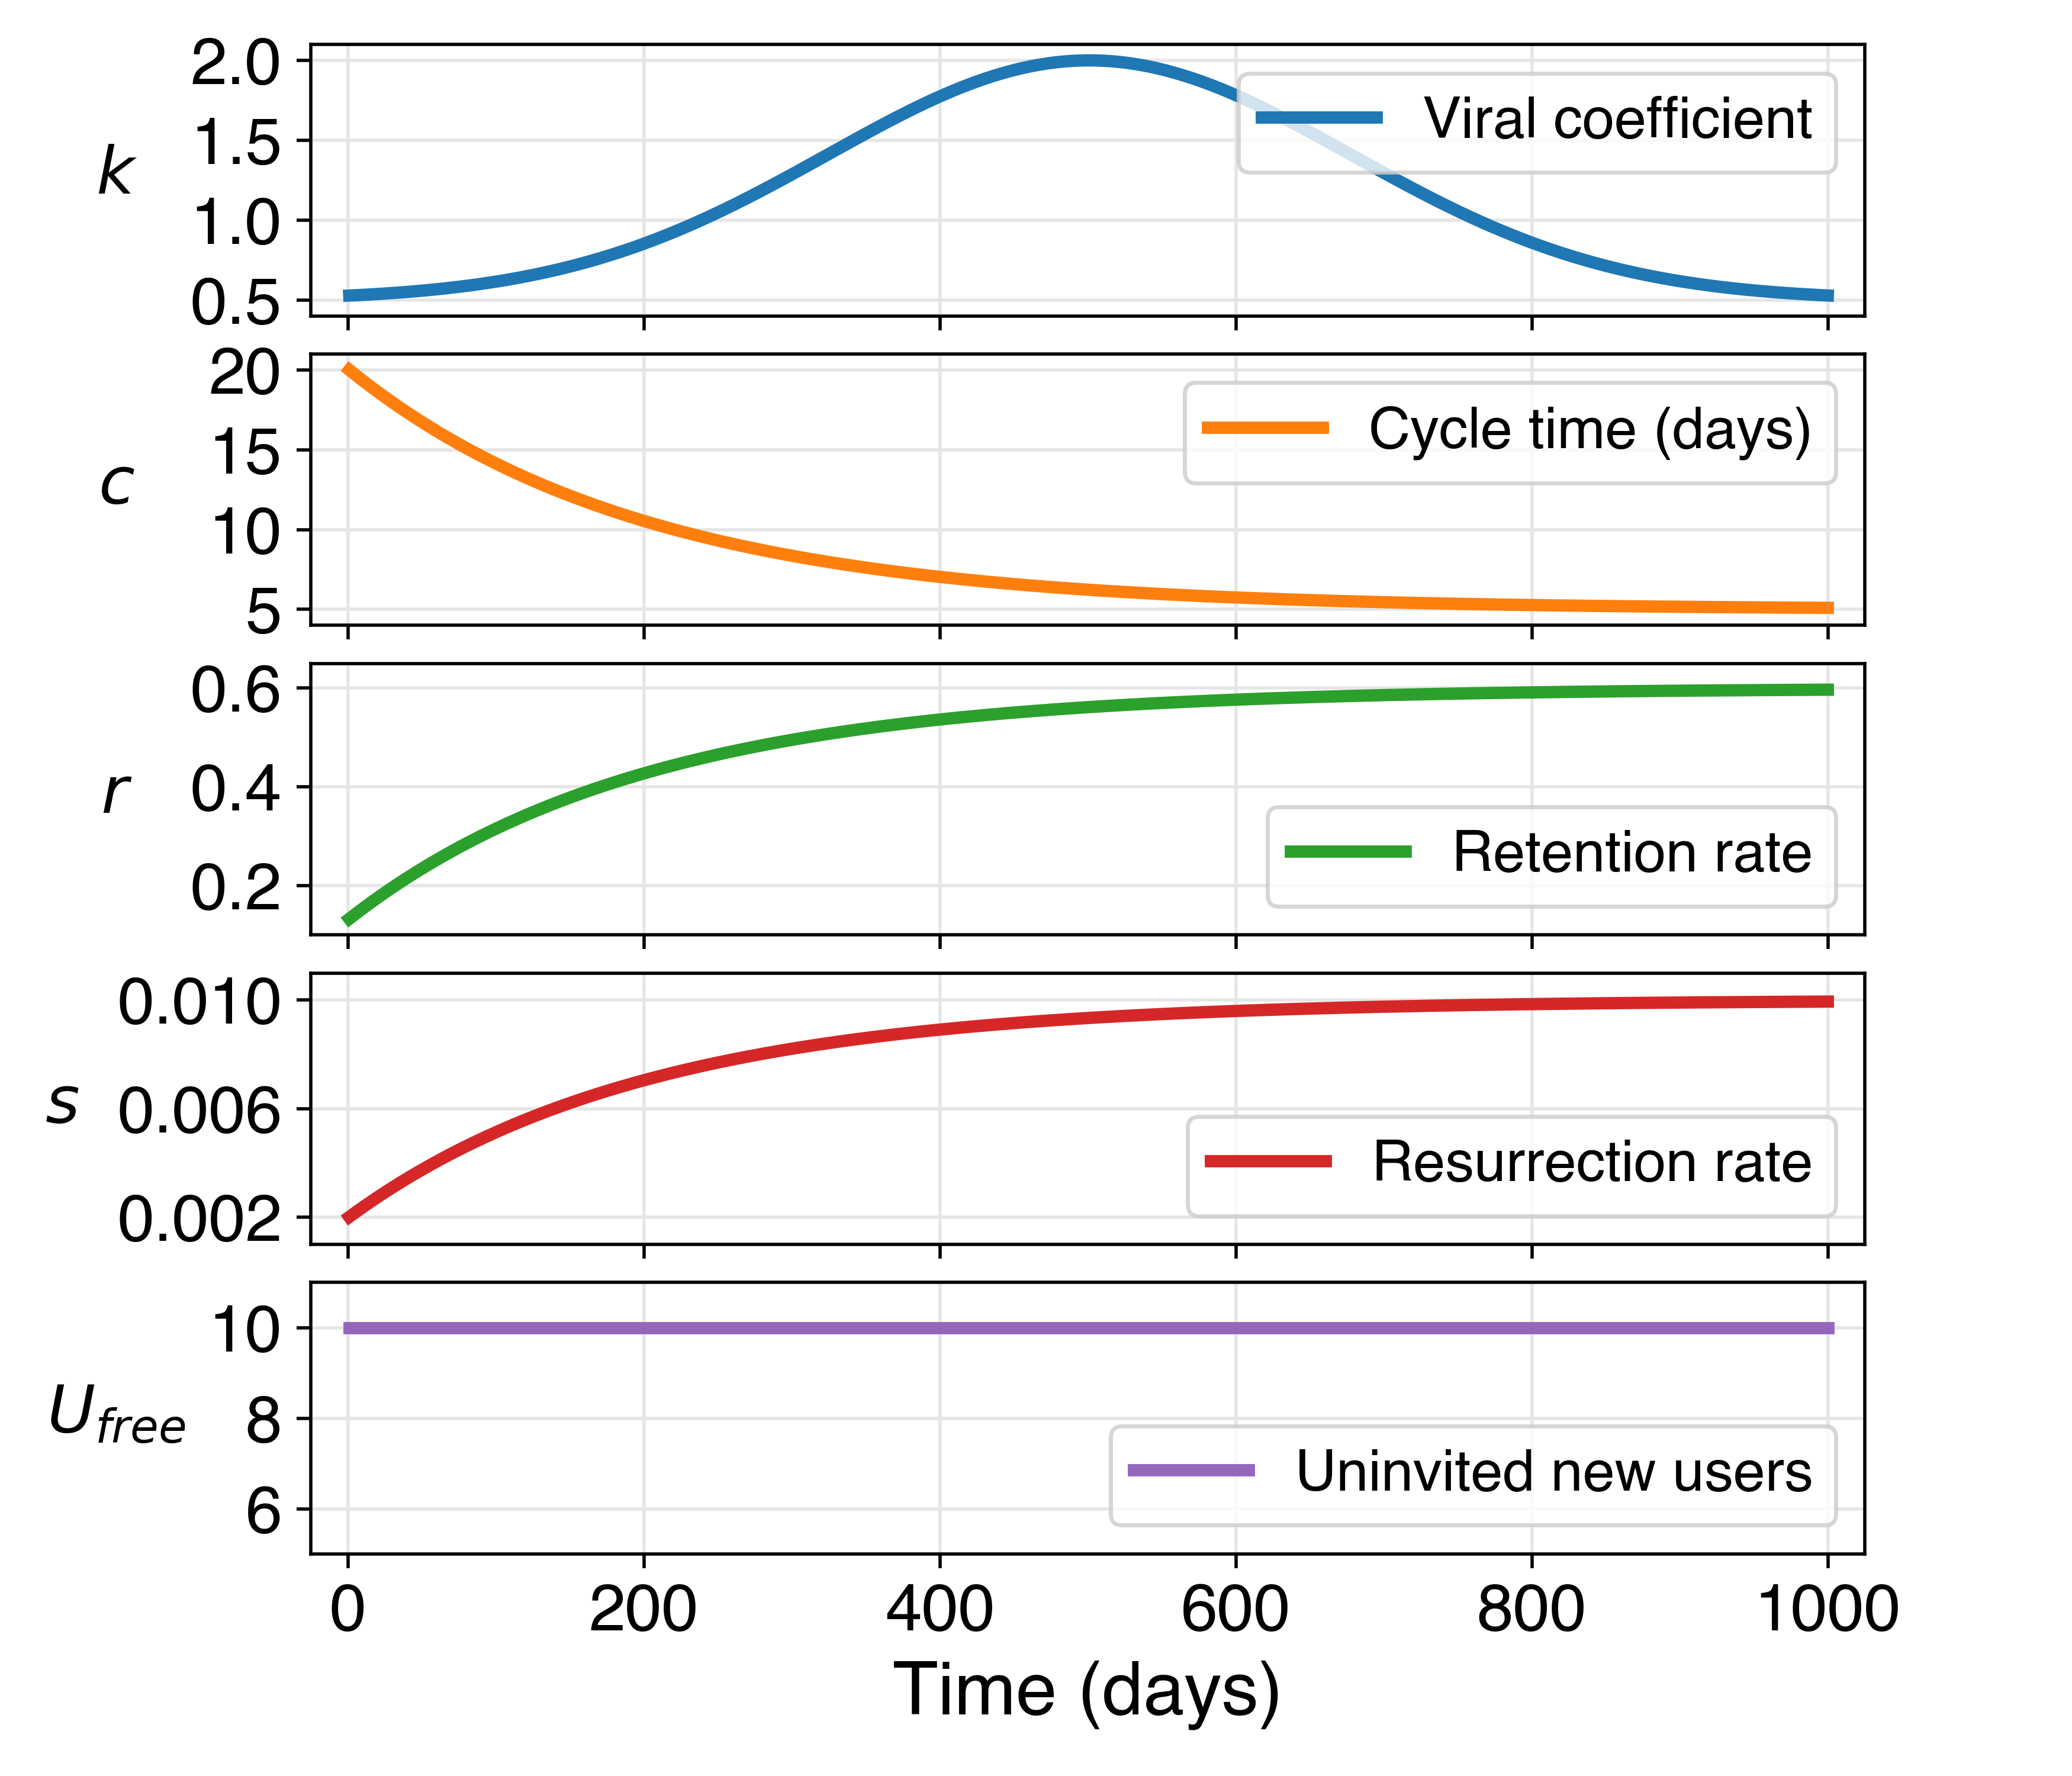
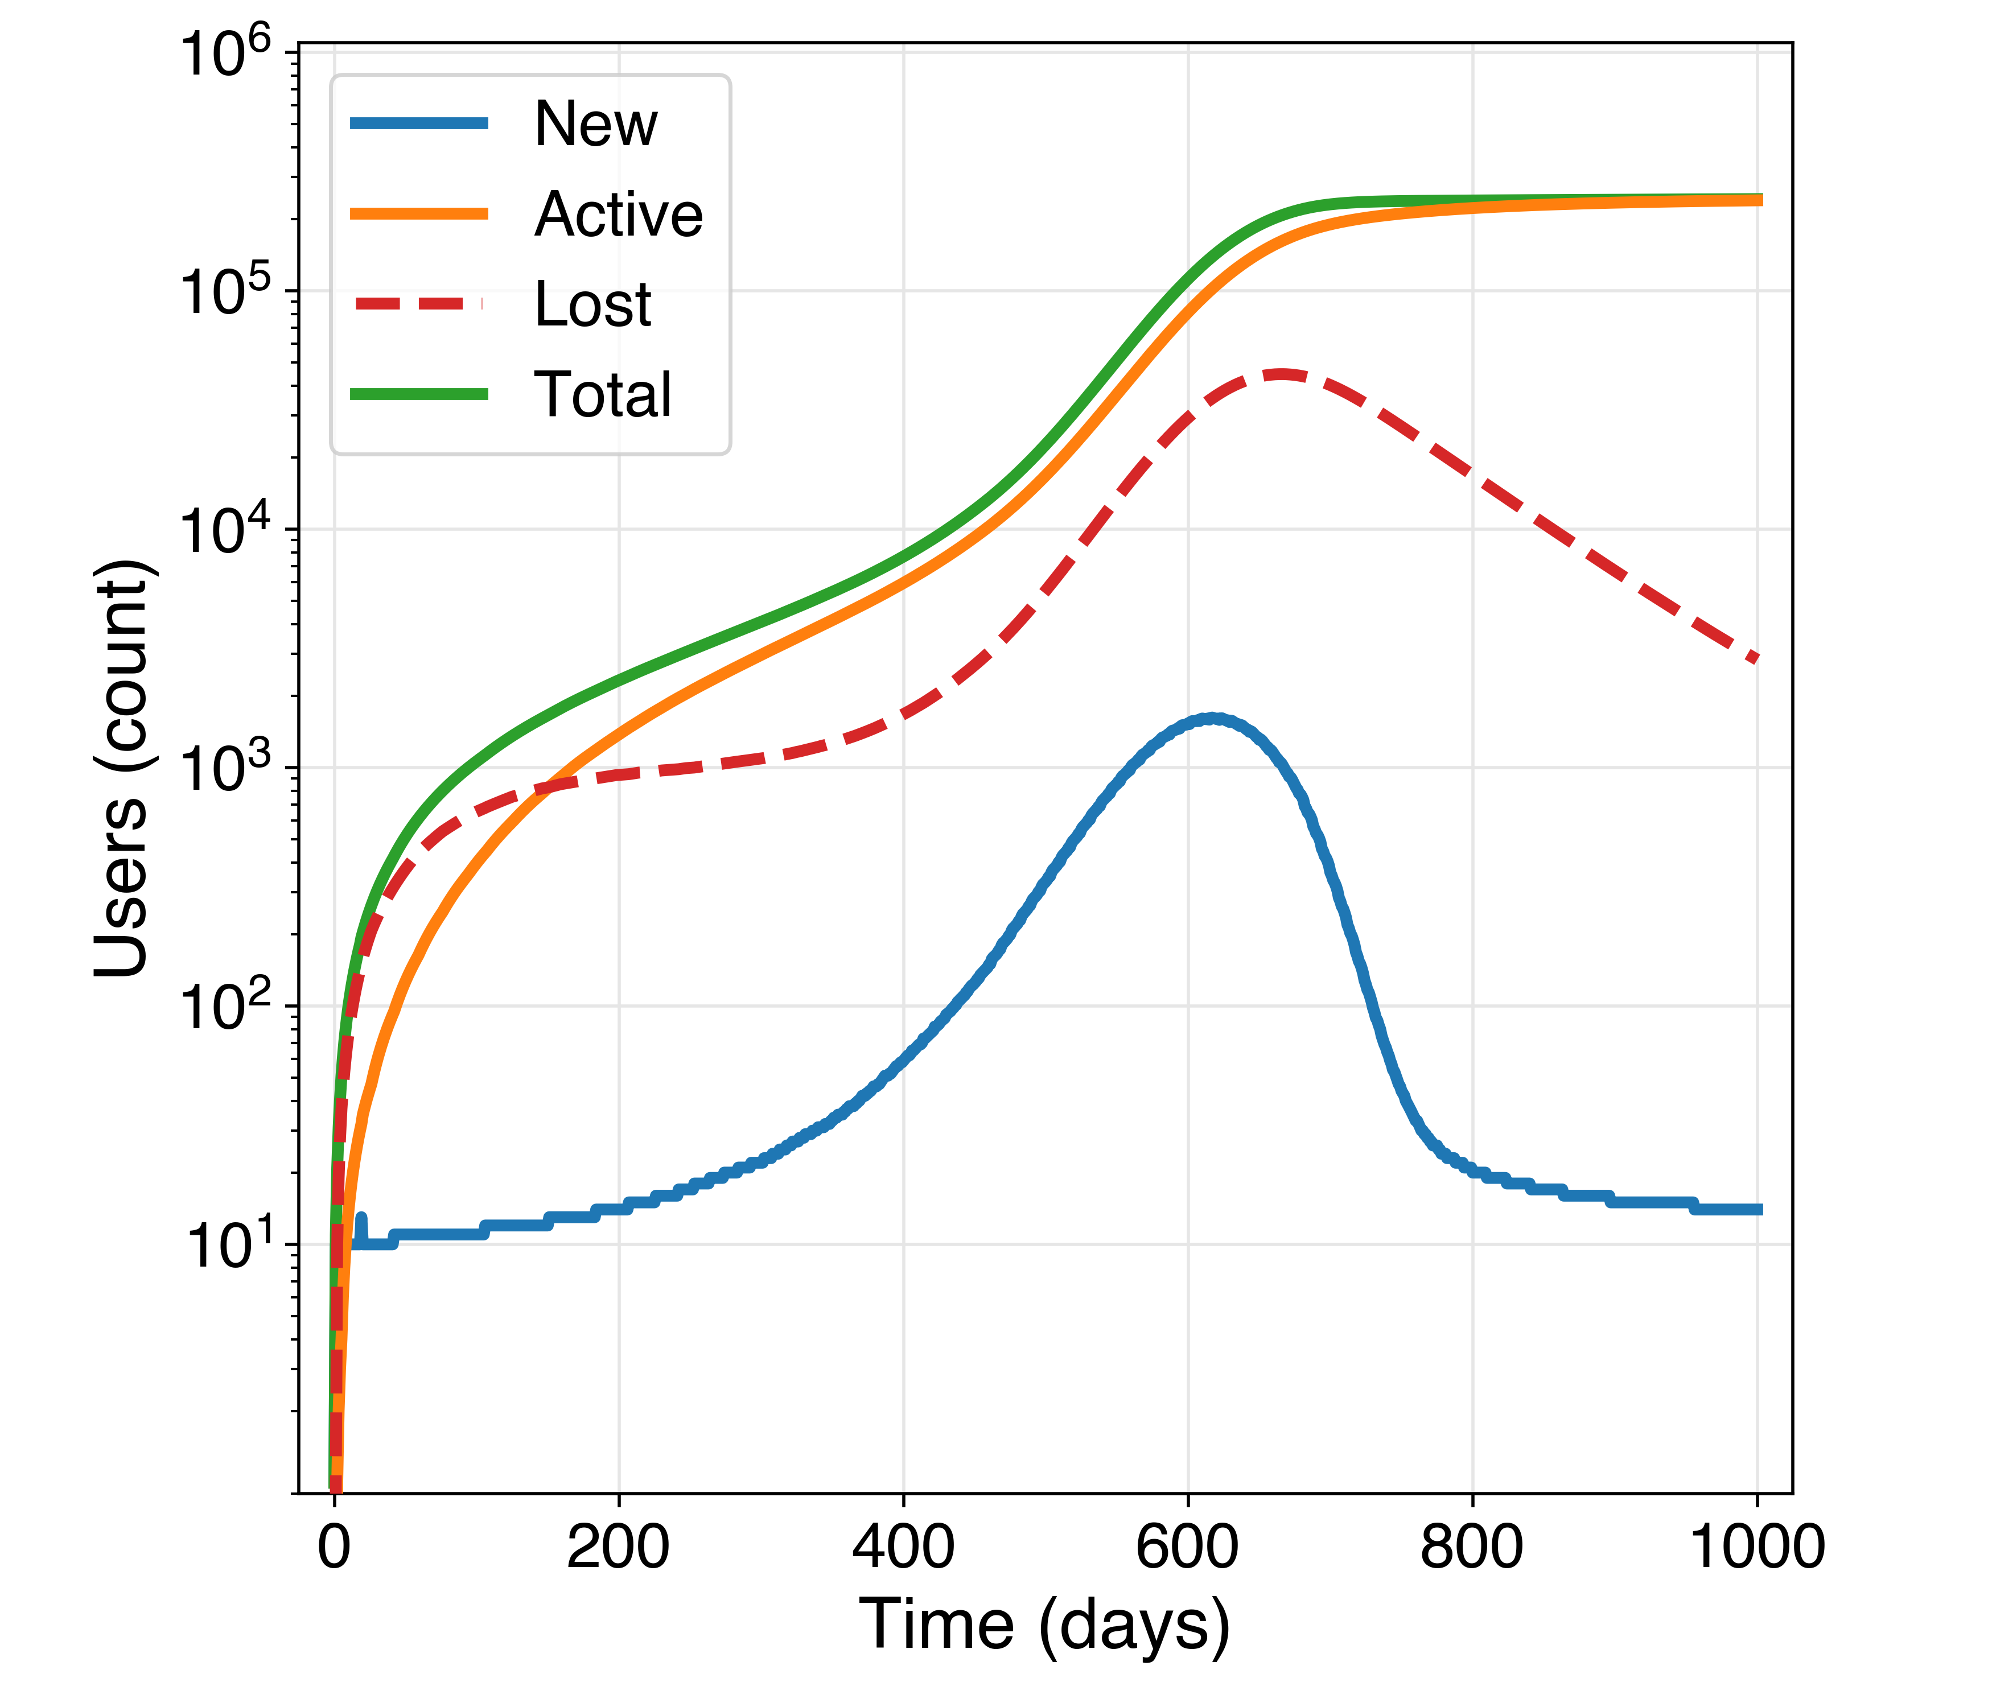
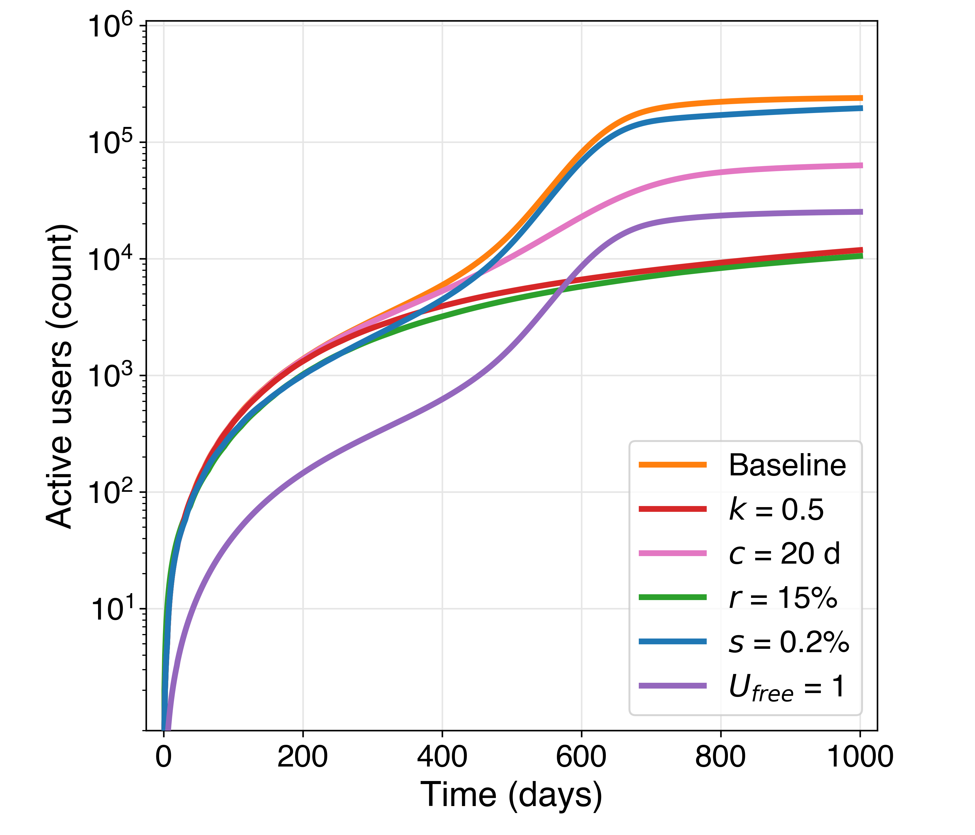

Slide 10
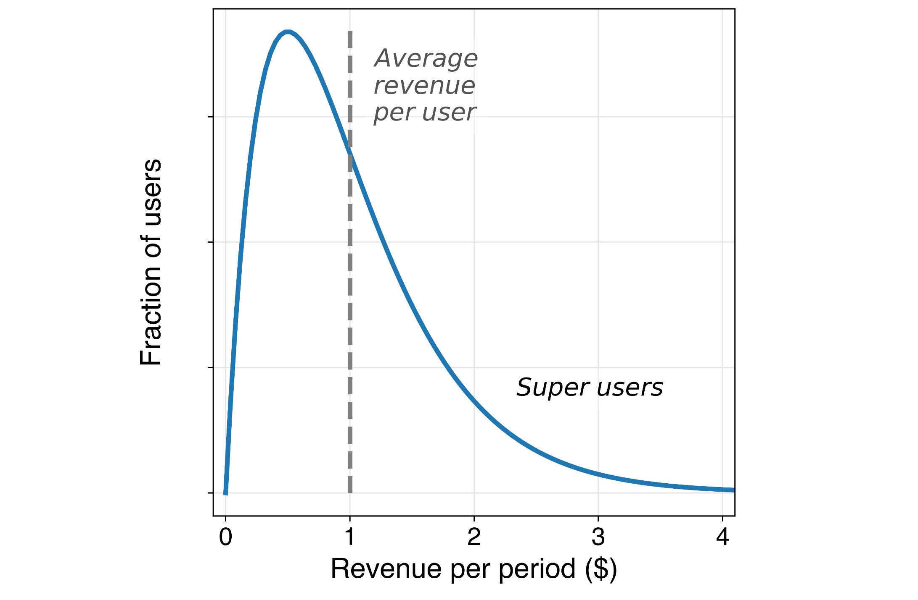

Slide 11
Revenue
Total active user count
Avg. revenue per user
=
x
Avg. purchase frequency
Avg. order value
x
General
Avg. user time on platform
Avg. revenue per ad
x
x
Avg. pageviews per unit time
Online advertising
x
Avg. no. of ads per page
x
Avg. click-through rate

Slide 12
Costs
Fixed costs
Total active user count
Avg. cost per user
=
+
x
Employee salaries
Avg. cost to acquire a user
Avg. cost of goods per user
+
+
Rent,
utilities
Avg. ad clicks per user
Avg. purchase frequency
+
Hardware, software
x
x
Avg. cost per click
Avg. order amount
+
÷
÷
Avg. clicks per conversion
(1 – gross margin)

Slide 13
Cash flows per unit time
Customer lifetime value
Avg. order amount
Avg. order frequency
Avg. contribution margin
Avg. customer lifetime
=
x
x
x

Slide 14
New users
Direct
URL entry
Bookmarks
Invitation
Referral from current user
Search
Google
App stores
Paid ads
Google
Facebook
YouTube

Slide 15
New users
Direct
URL entry
Non-web link
Referrals
Invites from current users
Search
Google
App stores
Paid ads
Google
Facebook
YouTube

